Slide 1
Economic Regulator: Options and Models Report
Recommendations
15 May 2013

Slide 2
Why is stronger Economic regulation needed?
Water Resources
DWA determines raw water pricing strategy and setting of the raw water charges, but also infrastructure developer & management body that spends the income
Substantial infrastructure portion of the raw water charge that is passed through institutions in the water value chain to end consumer. By way of illustration
Eg 1: the cost of raw water being 50% of the input costs to Rand Water

Slide 3
Why stronger ER is needed?
Eg 2: the depreciation element of the Infrastructure charge has been incorrectly
calculated by DWA since 2008. The Depreciation should have been calculated
on the Current Replacement Cost (as per the Pricing Strategy) of the Asset
Base but has instead been calculated on the Carrying value. The impact of
this has been an under charging of depreciation of approximately R428 million p.a.
(185% impact on total Depreciation revenue and 12% on total Infrastructure
Revenue.) This impact is illustrated in the table and graph below.

Slide 4
Why stronger ER is needed
Water Services
Little incentive to become more efficient
WBs face large backlogs in payments (from muni’s)
challenges for WSAs range from under-recovery of costs to inappropriate pricing impacts on the poor, poor service standards & high levels of non revenue water
Many WSAs do not understand the full cost of providing water & ensuring effective asset management and maintenance
WSAs are not appropriately ring-fenced & there is disjuncture between the billing services and water services resulting in inappropriate tariffs, poor billing & revenue collection

Slide 5
Objectives of of ER
Encourage efficient, affordable service provision (productive efficiency).
Set charges/tariffs for cost recovery to ensure long-term financial viability.
Ensure alignment between standards for service delivery (consumer protection) and charges/tariffs and funding requirements.

Slide 6
Objectives of ER (Cont)
Encourage appropriate investment (including extension of services).
Ensure the affordability of services to low income groups (social/equity objectives).
Provide dispute resolution mechanisms.

Slide 7
Definition of ER
“setting the rules to control, monitor, enforce and/or change tariffs/charges, tariff/charge determination structures and service standards for the water sector whilst recognising and supporting government policy and broader social, environmental and economic imperatives”

Slide 8
ER Scope (Cont.)
Where DWA, TCTA, WBs or CMAs are setting charges, the ER can determine what those charges should be
Where municipalities (WSA) are setting tariffs, the role of the ER is limited to setting norms and standards for tariff determination and service standards

Slide 9
Functions
Regulatory scope | Regulatory function/s | Regulatory objective | Regulatory inter-dependencies
Water resource management charges - DWA/CMAs | Set rules for raw water management charges determination. Approve raw water management charges. | Ensure reasonable charges to achieve catchment objectives. | Environmental / social (CMS)
 |  | Ensure financial sustainability of WM institutions.
 | Set special drought and seasonal tariffs | Water conservation and demand management | Environmental/social
 | Dispute resolution/ Regulatory review regarding charges | Deal with disputes/appeals. | Contractual/legal

Slide 10
Functions (cont.)
Regulatory scope | Regulatory Functions | Regulatory Objectives | Regulatory inter-dependencies
Water resource development charge – DWA /TCTA | Set rules for raw water development charge determination. Approve water development charges. | Ensure reasonable charges.
 |  | Sustainability of institutions.
 |  | Consumer/user protection. | Environmental
 |  | Strategic asset management. | Technical/standards/safety
 | Determine charges for raw water quality treatment infrastructure/processes. | Financial sustainability. Raw water quality. Consumer/user protection. | Environmental/ Technical
 | Dispute resolution/ Regulatory review re charges | Deal with disputes/appeals | Contractual/legal

Slide 11
Functions (cont.)
Regulatory scope | Regulatory Functions | Regulatory Objectives | Regulatory inter-dependencies
Other water charges (e.g. future AMD entities/tertiary treatment) | Set rules for sale of water between entities. Approve such water charges/tariff. | Ensure reasonable charges.
 |  | Sustainability of institutions.
 |  | Consumer/user protection. | Environmental
 |  | Strategic asset management. | Technical/standards/safety
 | Determine charges/tariffs for sale of treated water. | Raw water quality. Consumer/user protection. | Environmental/ Technical
 | Dispute resolution/ Regulatory review re charges/tariffs | Deal with disputes/appeals. | Contractual/legal

Slide 12
Regulatory scope | Regulatory Functions | Regulatory Objectives | Regulatory inter-dependencies
Bulk water tariffs and service standards | Set rules for determination of bulk potable water tariffs. Approve bulk potable water tariffs. Recommended bulk potable water tariffs where a municipality supplies other entities. | Ensure reasonable charges for bulk potable water customers. Sustainable institutions.
 | Monitor cost implications of compliance with drinking water quality standards. | Cost of compliance with service standards (SANS 241). Sustainable institutions. Customer protection. | Health
 | Set rules for determination of bulk raw water tariffs. Approve bulk raw water tariffs . Recommend bulk raw water tariffs where a municipality has own supply/supplies other entities. | Ensure reasonable charge for bulk raw water customers.
 |  | Sustainability of institutions.
 | Monitor cost implications of compliance with bulk raw water quality standards. | Costs of compliance with aw water quality service standards. Sustainable institutions. Customer /user protection. | Environmental/ Technical
 | Assess reliability of supply (strategic asset management). | Specifying asset Conditions. Norms and standards complied with. | Technical/ social
 | Customer/consumer protection. | Norms and standards complied with.
 | Monitor efficiency and serviceability of supply | Specifying efficiency and performance targets. Benchmarking. | Technical / social

Slide 13
Regulatory scope | Regulatory Functions | Regulatory Objectives | Regulatory inter-dependencies
 | Dispute resolution/ regulatory review. | Deal with disputes/appeals. | Contractual/legal
Retail water tariffs and service standards | Set rules for determination of retail water tariffs. Assess compliance with retail tariff determination rules and make recommendations. | Ensure reasonable charges for retail water to customers.
 |  | Sustainability of institutions. Norms and standards complied with.
 | Monitor costs for compliance with drinking water quality standards. | Costs of compliance with water quality service standards (SANS 241). Consumer protection. | Health
 | Monitor reliability of supply (strategic asset management). | Specifying asset Conditions. Norms and standards complied with. | Technical/social
 | Customer protection. | Norms and standards complied with.
 | Monitor efficiency and serviceability of supply | Specifying efficiency and or performance targets. Benchmarking. | Technical/social
 | Service coverage. | Service coverage targets met. | Social
 | Dispute resolution/regulatory review. | Deal with disputes/appeals. | Contractual/legal

Slide 14
Regulatory scope | Regulatory Functions | Regulatory Objectives | Regulatory inter-dependencies
Sanitation Charges and service standards. | Set rules for determination of sanitation charges (tariffs). Assess compliance with sanitation charges (tariffs) determination rules and make recommendations. | Ensure reasonable charge for sanitation services to customers.
 |  | Sustainability of institutions.
 | Monitor reliability of service (strategic asset management). | Specifying asset Conditions. Norms and standards complied with. | Technical/social
 | Customer protection. | Norms and standards complied with.
 | Monitor efficiency and serviceability of supply. | Specifying efficiency and or performance targets. Benchmarking. | Technical/social
 | Monitor service coverage. | Service coverage targets met. | Social
 | Dispute resolution and regulatory review. | Deal with disputes/ appeals. | Contractual/legal

Slide 15
Regulatory scope | Regulatory Functions | Regulatory Objectives | Regulatory inter-dependencies
Bulk waste water charges and service standards | Set rules for determination of bulk sanitation/waste water charges (tariffs). Assess compliance with bulk sanitation/waste water tariff determination rules and make recommendations | Ensure reasonable charge for sanitation customers.
 |  | Financial sustainability of institutions.
 | Monitor reliability of service. | Specifying asset conditions. Norms and standards met. | Technical/social
 | Customer protection. | Norms and standards met.
 | Monitor efficiency and serviceability of supply. | Specifying efficiency and or performance targets. | Technical/social
 | Dispute resolution/ regulatory review | Deal with disputes/ appeals. | Contractual/legal

Slide 16
Regulatory scope | Regulatory Functions | Regulatory Objectives | Regulatory inter-dependencies
Waste discharge charge. | Set rules for waste discharge charge determination. Approve waste discharge charge. | Ensure reasonable charges. | Environmental
 |  | Financial sustainability of institutions. Protect water quality and consumers | Environmental/ Health
 | Dispute resolution/regulatory review. | Deal with disputes/ appeals. | Contractual/legal
International agreements/ charges | Set rules for review of existing raw water charges. | Ensure reasonable charges. | Environmental
 |  | Sustainability of institutions.
 | Set rules for determination of raw water charges for new schemes/ agreements. Approve new raw water charges. | Ensure reasonable charges. | Environmental
 |  | Sustainability of institutions.
 | Dispute resolution/ regulatory review | Deal with disputes/ appeals. | Contractual/legal

Slide 17
Corporate Forms
3 corporate forms proposed/assessed
Unit / branch internal to the DWA
National Government Component (external to DWA, but internal to public services)
NPE – external to DWA and public service
Main Concerns
Role separation
Skills acquisition and retention
Ability to enforce rules – all subject to IGRFA
Work Stream- Preference of Stakeholders = NGC

Slide 18
CRITERIA | Option 1 (Inside Branch) | Option 2 (Government Component) | Option 3 (External Regulator)
 | Degree of Alignment ( 2= good; 1 = partial, 0 = weak)
Regulatory legitimacy
Is the action or regime supported by legislative authority | 1 | 2 | 2
Is there an appropriate scheme of accountability | 1 | 2 | 2
Are procedures fair, accessible and open | 2 | 2 | 2
Is the regulator acting with sufficient expertise | 1 | 1 | 2
Is the action or regime efficient | 1 | 2 | 2
Regulatory Best Practice (Do the options address regulatory principles?)
Clear Roles | 0 | 2 | 2
Transparency Accountability/Non discriminatory | 1 | 1 | 2
Independence/Autonomy | 0 | 1 | 2
Participation | 2 | 1 | 2
Effective Monitoring and Enforcement | 1 | 1 | 2
Minimal Regulation | 2 | 2 | 2
Predictability | 1 | 2 | 2
Judicial review | 1 | 1 | 2
Water Sector Fit (Does the option facilitate?)
Building on existing regulatory capacity and structures | 2 | 2 | 2
Progressively building regulatory capacity within the sector institutions. | 2 | 2 | 1
Introducing more appropriate separation of roles and responsibilities | 0 | 1 | 2
Addressing existing critical regulatory gaps and constraints. | 0 | 1 | 2
Ensuring that the existing water sector “market failures” are addressed on a priority basis. | 1 | 2 | 2
Enables “quick wins” to be made. | 2 | 0 | 0
Accommodates the regulatory preferences of key sector stakeholders | 0 | 1 | 2

Slide 19
Organisational Design
Proposed OD assumes legislative amendments to NWA and WSA to facilitate effective ER as per scope and functions
64 staff
Gradual phasing in of staff during 5 years after establishment
Board must be appointed (year 1)
review BC, oversee development of BP and recruit CEO
Once CEO appointed (year 2)
May revise BP and recruit executive team
Appointment of additional staff for core economic regulation function (years 3 and 4)
Rely on PSPs initially
Focus will be on research to understand market and develop regulatory methodology
Perform economic regulation (year 5)
64 staff
Minimal reliance on PSPs

Slide 20
Board
CEO (3)
Water Value Chain ER
(3)
Regulatory Support Services (2)
Corporate Services (2)
Pricing and Tariffs (17)
Legal (5)
Finance and Admin(5)
Coms & Stakeholder Management (5)
CME(11)
Internal Audit (2)
Regulatory Research Reform and knowledge management (3)
IT (2)
Dispute Resolution/ Client services
(3)
HR (3)

Slide 21
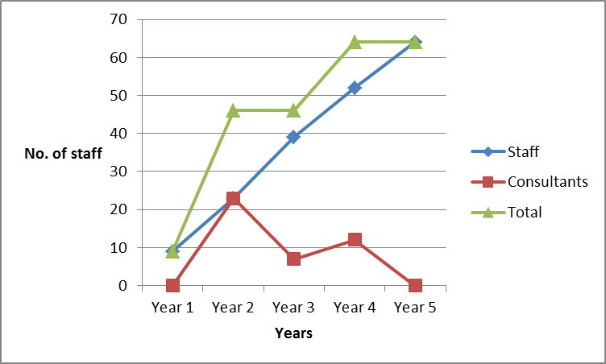
Organisational Design
 | Year 1 |  | Year 2 |  | Year 3 |  | Year 4 |  | Year 5
Staff | 9 | 0 | 23 | 23 | 39 | 23 | 52 | 12 | 64 | 0

Slide 22
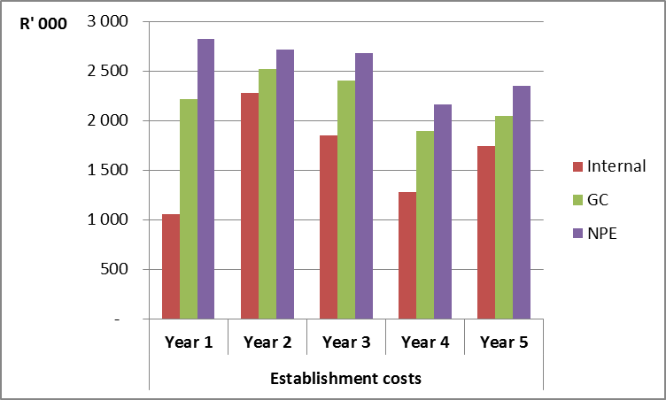
Cost of Economic Regulator
All corporate forms
Cost comparator (Establishment costs)

Slide 23
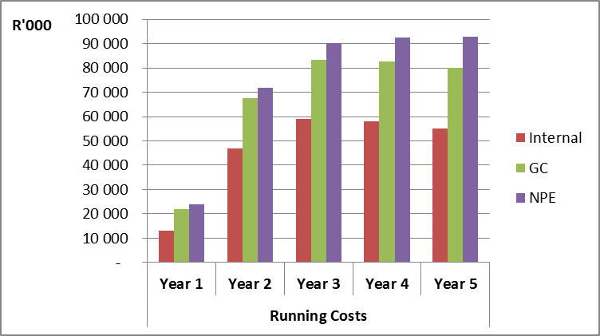
Cost of Economic Regulator
All corporate forms
Cost Comparator (Operating Costs)

Slide 24
Cost of Economic Regulation
Summary estimated costs (internal unit)

Slide 25
Cost of Economic Regulation
Summary estimated costs (NGC)

Slide 26
Cost of Economic Regulator
Summary estimated costs of the ER (NPE)

Slide 27
Sources of Revenue
Economic Regulation Charge
Requires legislation
Set by ER
ER invoices DWA
DWA collects the ERC obo the ER and transfers money to ER
TCTA, WRC and CMAs

Slide 28
Sources of Revenue
Basic principle – water users to pay
BUT – users most likely to benefit = industrial and domestic (higher end of the value chain)
Charges/ tariffs they pay not covered by pricing strategy
Raw water users will also benefit from having an ER
How should the cost of Economic Regulation be covered?
Separate charge or added to an existing charge
In terms of current legislation, not possible to implement a charge
Have to be included in either WRM or NWRI charge
WRM
User base small and the full cost may burden the users
NWRI
ER is critical to ensure effective asset management and effective maintenance over time
Draft Pricing strategy – included the ER charge as part of the indirect operation and maintenance costs of the NWRI charge

Slide 29
Sources of Revenue
Main source of income = ER charge
Charge to cover costs of operations with no profit element
ER is not expected to receive a grant
Based on the registered volume of 10 billion m³ the ER Charge may be 1.03c
The following tables models the impact of adding the ER Charge to the WRM and NWRI charges
Industry | Ave charge (c/m³) : 2012/2013 | ER charge (c/m³) | % of existing charge
D&I | 2.62 | 1.03 | 39%
IRR | 2.15 | 1.03 | 48%
Forestry | 1.29 | 1.03 | 79%
Industry | Ave charge (c/m³) : 2012/2013 | ER charge (c/m³) | % of existing charge
D&I | 74.03 | 1.03 | 1%
IRR | 9.16 | 1.03 | 11%

Slide 30
Sources of Revenue
The Bergriver (Voelvlei Dam)
The impact of the addition of the ER charge not significant
SMP ID | Sector | Registered Volume ('000 m³) | 2011/2012 Charges (c/m³) | Theoretical Billing (R'000 ) | ER charge (c/m³) | New charge (c/m³) | Revised Billing (R'000 ) | Additional Billing (R'000 ) | % of existing Billing
4 | Irr | 11 518 | 2.10 | 242 | 1.03 | 3.13 | 360 | 119 | 49%
45 | D&I | 4 274 | 18.02 | 770 | 1.03 | 19.05 | 814 | 44 | 6%
121 | D&I | 70 400 | 38.96 | 27 428 | 1.03 | 39.99 | 28 153 | 725 | 3%
127 | Irr | 14 552 | 9.64 | 1 403 | 1.03 | 10.67 | 1 553 | 150 | 11%
411 | D&I | 704 | 18.02 | 127 | 1.03 | 19.05 | 134 | 7 | 6%
412 | D&I | 17 476 | 20.54 | 3 590 | 1.03 | 21.57 | 3 770 | 180 | 5%
413 | D&I | 1 500 | 20.54 | 308 | 1.03 | 21.57 | 324 | 15 | 5%
 |  | 120 423 |  | 33 868 |  |  | 35 108 | 1 240 | 4%

Slide 31
Summary Recommendations
Definition, scope & functions require legislative amendments
Based on assessment criteria and stakeholder preferences the NGC is recommended
Greater role separation than with internal unit
Recruitment of highly skilled staff
But establishment takes time
64 staff – phased in gradually
Cost of ER, as a NGC in year 5 = R82 million
Create an ER charge that is included in the NWRI (O & M) charge
ER charge is 1.03c to cover cost of regulator

Slide 32
THANK YOU

